Slide 1
ONLINE EXAMINATION SYSTEM
-MRUNALI KERKAR

Slide 2
On first index page, There are two login, One is for Teacher and another
one is for Student Login and Register
Teacher can Login , Teacher’s Login Id and Password had saved in oracle database.
Student can login and register itself.
After login of student, Student can take exam, and after submitting exam they are able to
see their obtained marks.
After login of teacher, Teacher can add questions for exam.
After submitting test, student can logout themselves from exam.

Slide 3
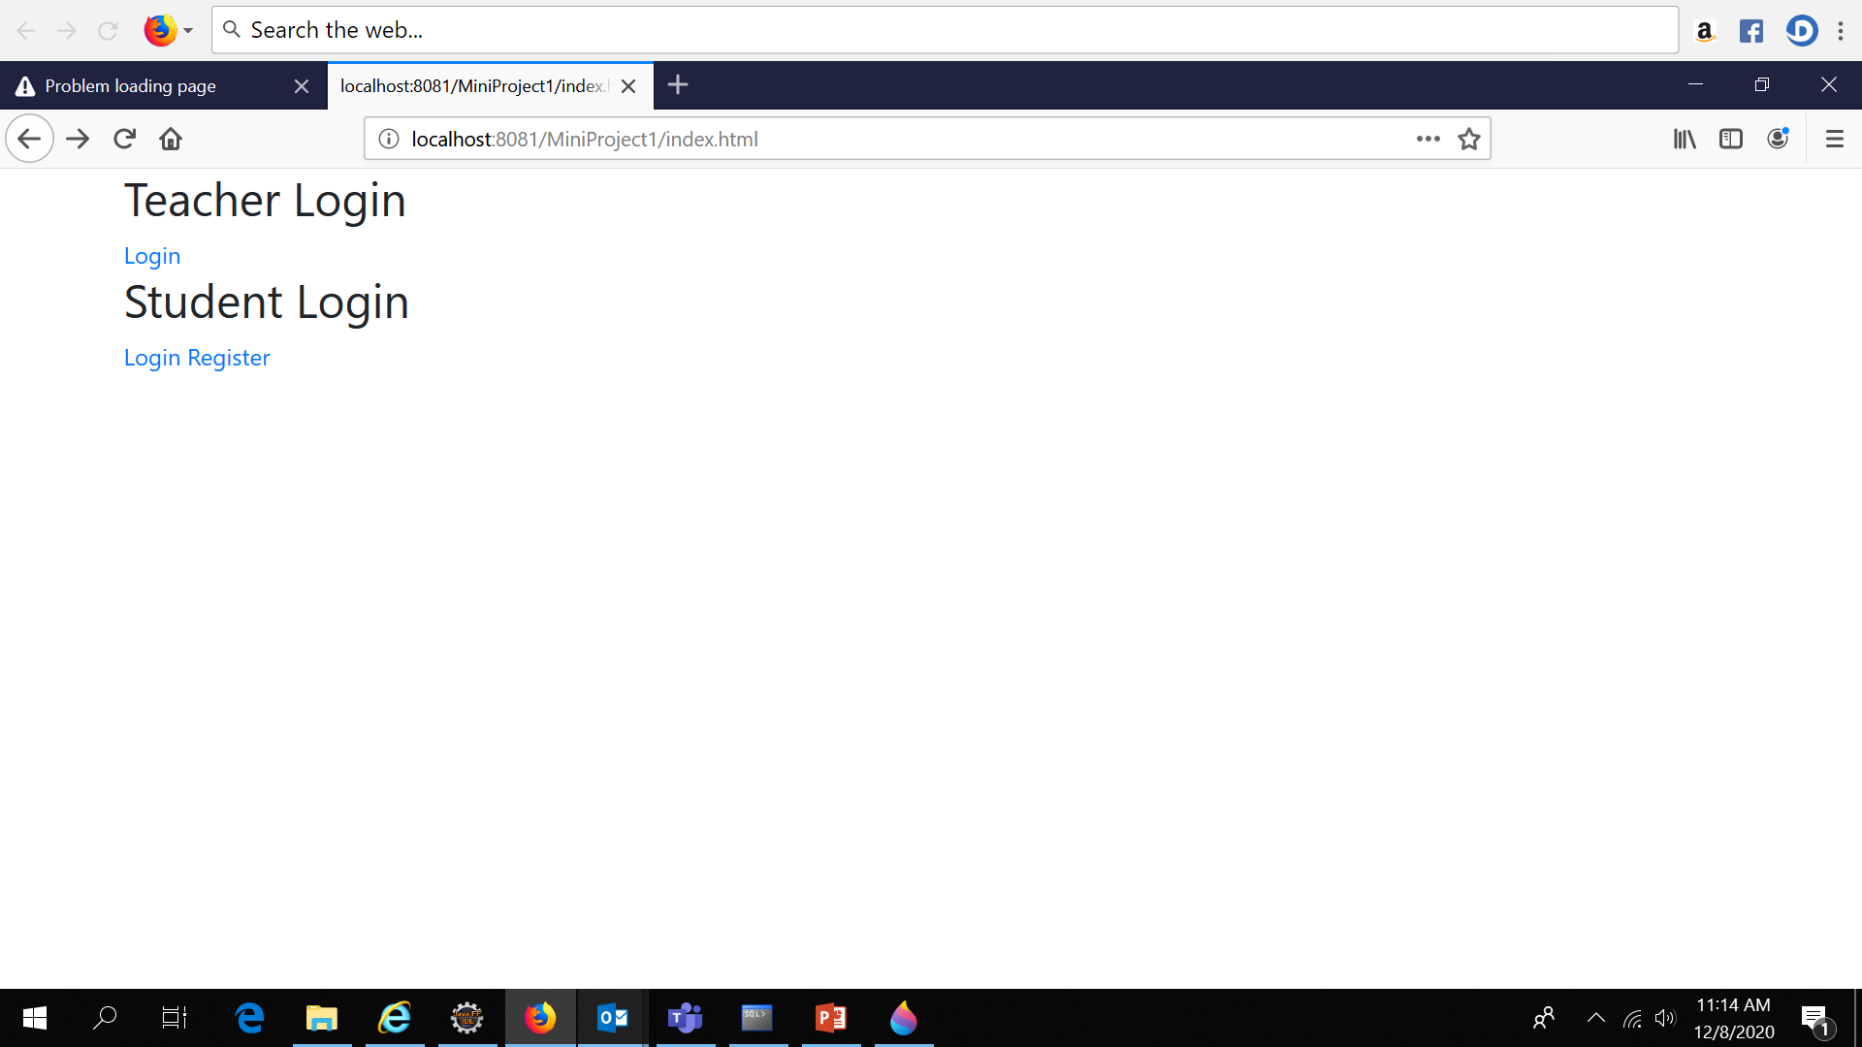

Slide 4
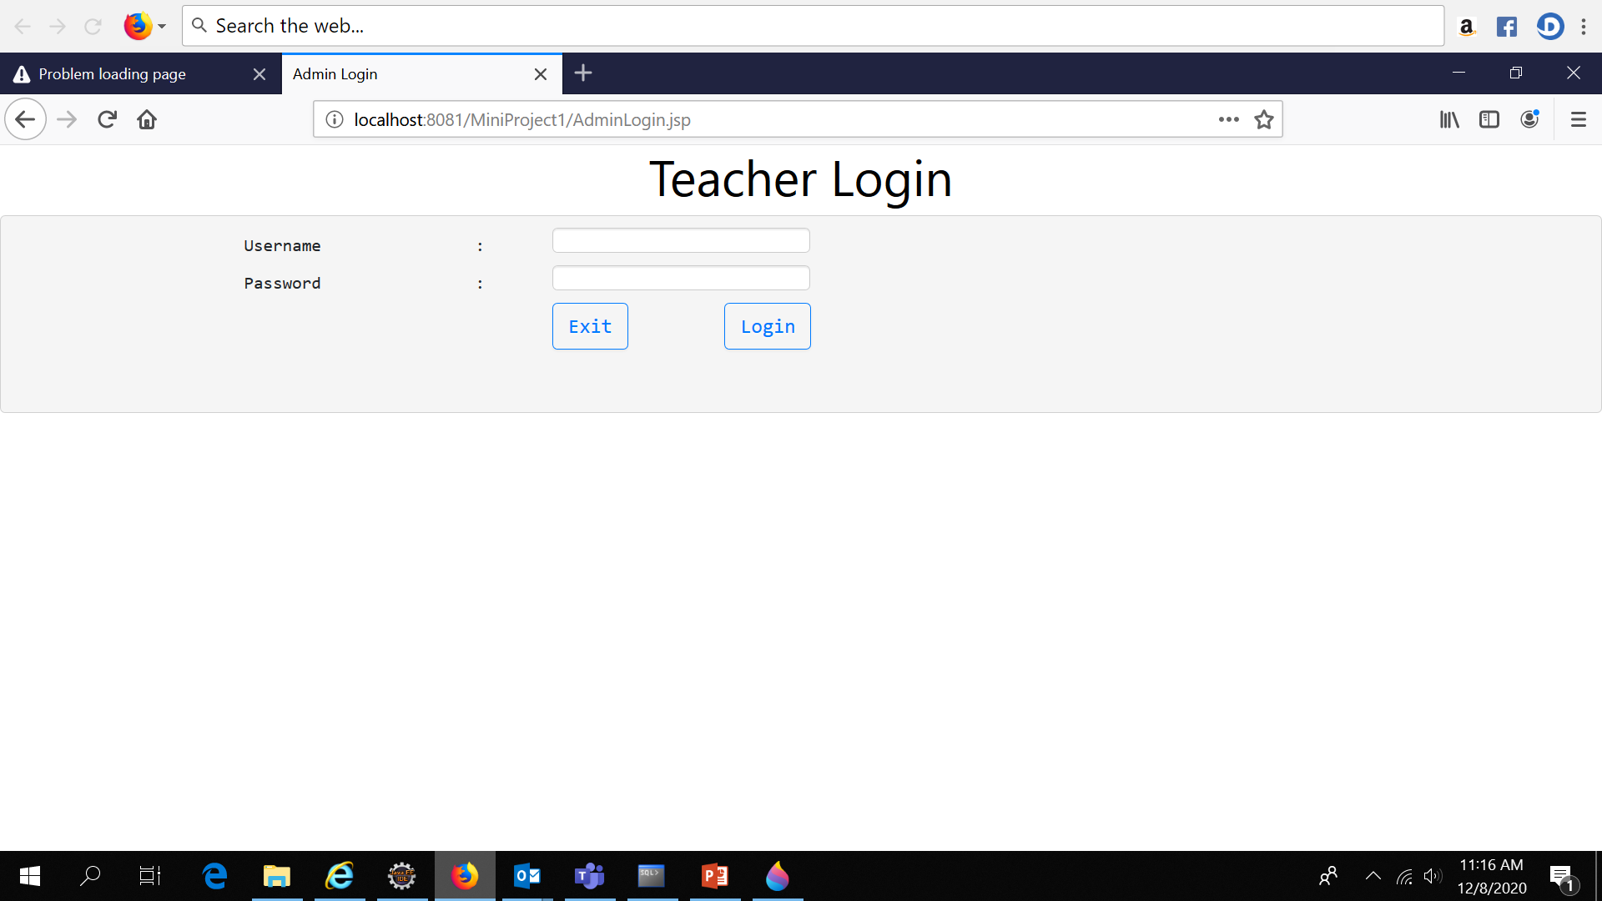
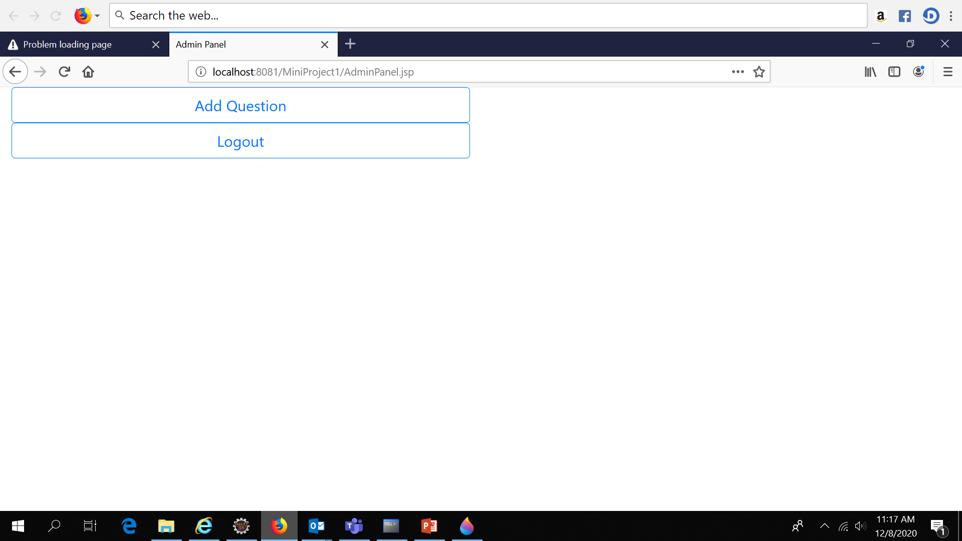

Slide 5
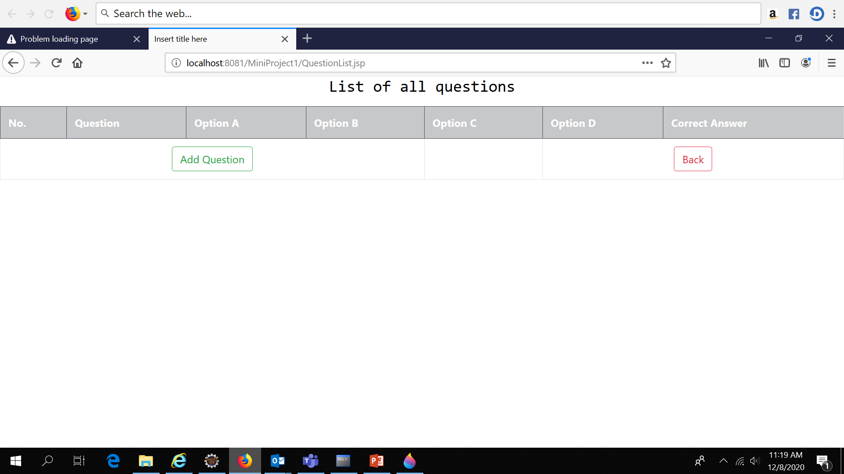
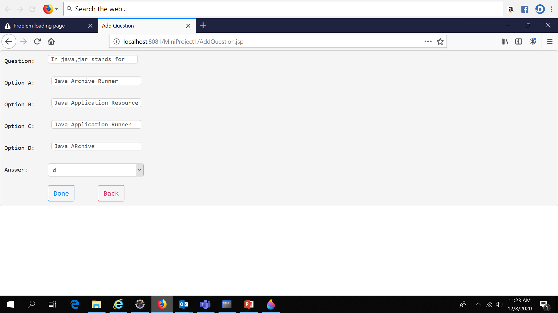

Slide 6
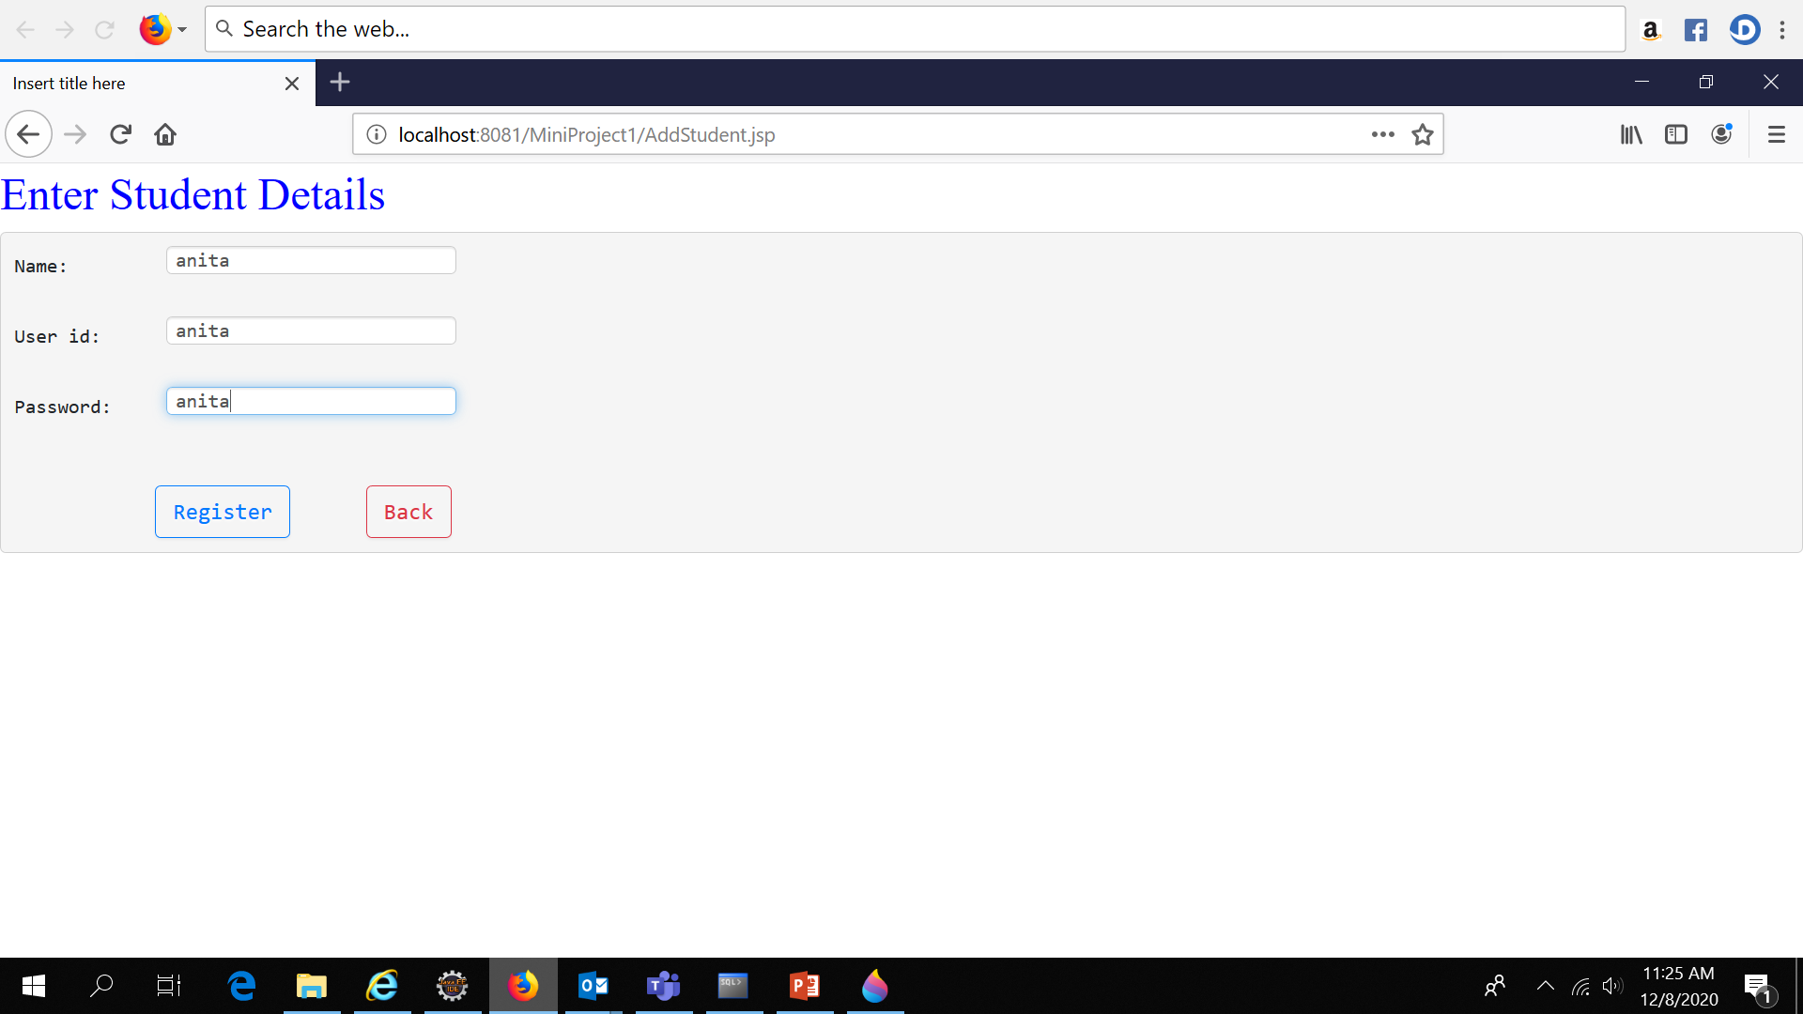
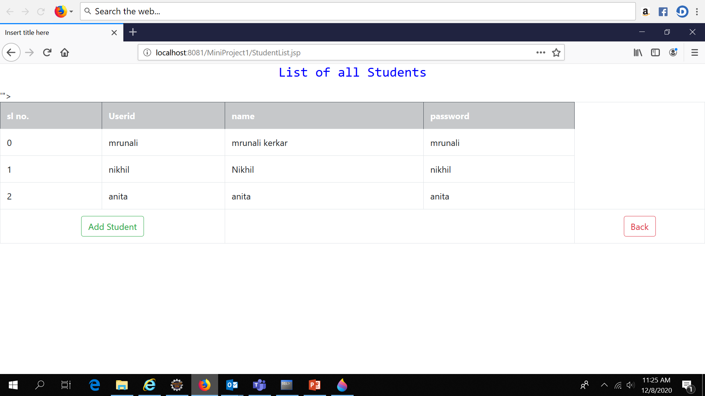

Slide 7
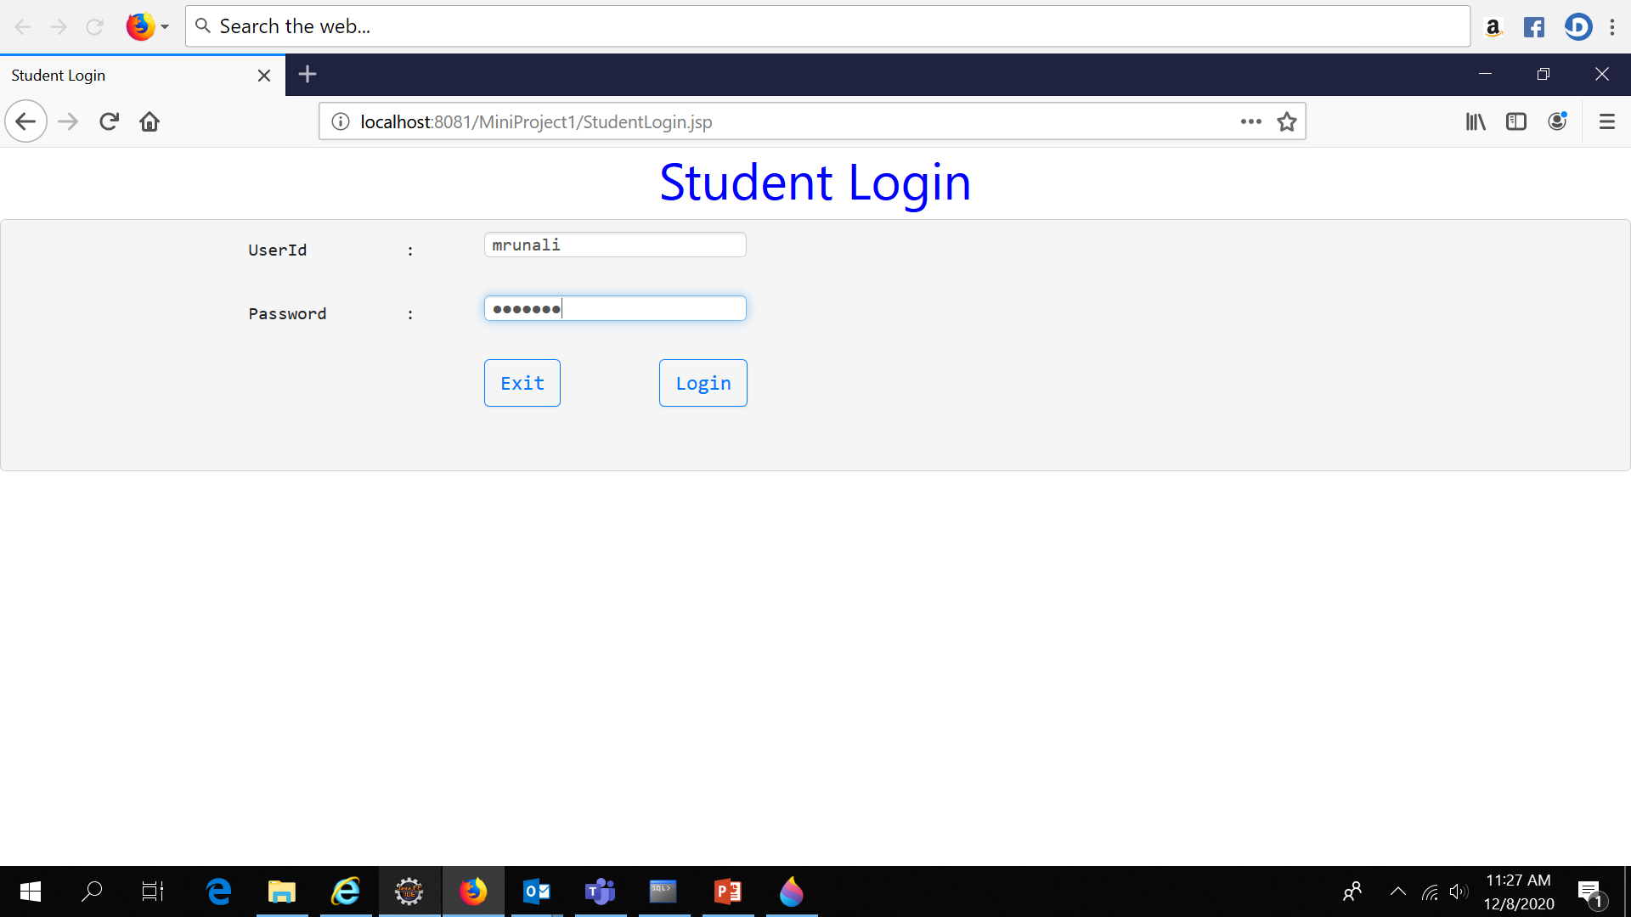
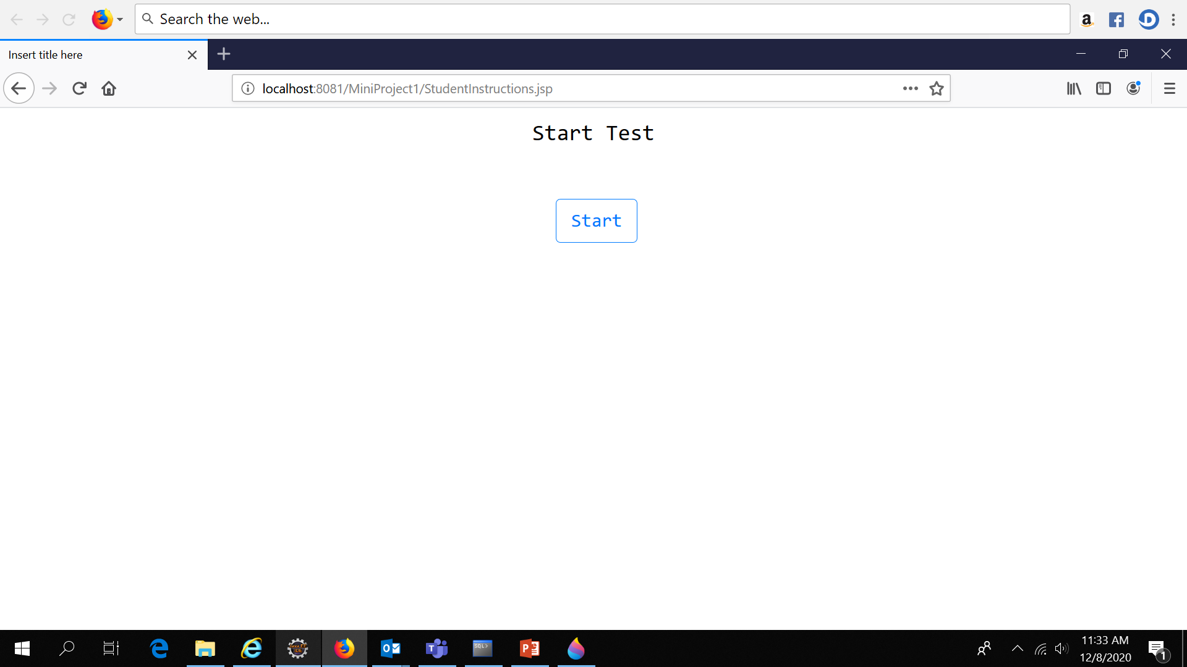

Slide 8
